Slide 1


Advisor : Hoon Sung Chwa
Weekly Meeting
25.05.26.
Dept of Electronic Engineering & Computer Science, DGIST
Real-Time Computing Lab
Moonyoung Choi (cmy021205@dgist.ac.kr)
Notes:
Weekly meeting 표지

Slide 2
Goal
Goal: Analyzing Latency in Autonomous Drone Navigation via Offboarding
Requirement:
Understanding the Logic of Autonomous Drone Navigation via Offboarding
Analyzing Latency at Each Stage of the Process
Testing ROS Topics Required for Latency Measurement and Autonomous Navigation
Keepalive message priority 낮추기
이 연구의 범용성(확인하기)
어플이랑 이런거 좀더 공부 해봐야될듯
2

Slide 3
Background(Onboarding & Offboarding)
On-boarding
Off-boarding
PX4 SITL
hardware 역할
Gazebo
Simulator
PX4: 드론 제어 펌웨어
MAVLink: UAV 통신 protocl
MAVROS: DDS↔MAVLink 변환
ROS2
ros2 node
message pub
MAVROS
mavros node
DDS to MAVLink
PX4 SITL
hardware 역할
Gazebo
Simulator
Latency 발생
3

Slide 4
Background(Offboarding Mechanism)
ROS 2
service call
MAVROS
/mavros_node
Node 1
/cmd/arming
Node 2
/cmd/takeoff
x: 1.0
y: 1.0
z: 5.0
Node 3
/cmd/set_mode
현재 드론
상태
topic pub
x: 1.0
y: 1.0
z: 5.0
Topic 1
/cmd/set_posi
PX4 SITL
Node 4
/cmd/set_posi
현재 드론
상태
keep-alive message
(offboard mode 유지)
Node 5
/cmd/battery
Topic 2
/cmd/state
4

Slide 5
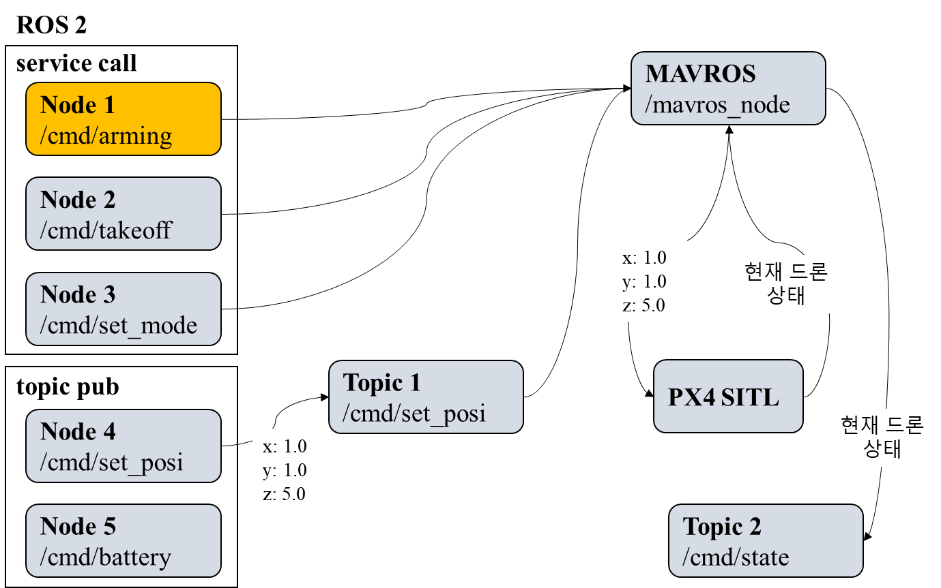
Experiment
Arming 명령 Latency 측정
On-boarding: 4ms~8ms
Off-boarding: 100ms~1000ms
Keep-alive message로 인한 MAVROS queue 과부하
Objective
Keep-alive message 주기 조정
다른 명령 추가
X: 1.0 Y: 1.0 | X: 1.0 Y: 1.0 | X: 1.0 Y: 1.0 | X: 1.0 Y: 1.0 | X: 1.0 Y: 1.0 | arming | X: 1.0 Y: 1.0 | X: 1.0 Y: 1.0 | X: 1.0 Y: 1.0 | X: 1.0 Y: 1.0
5

Slide 6
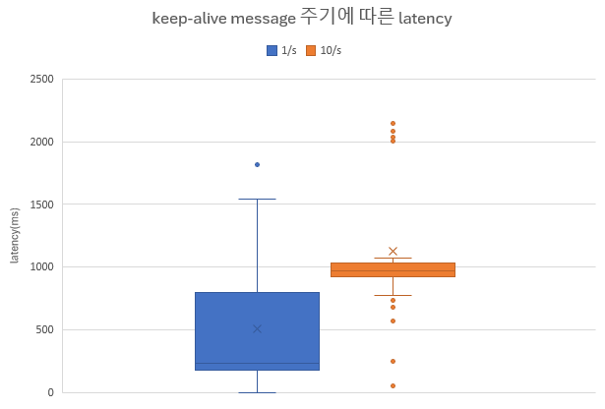
Keep-alive message 주기 조정
1초에 전송되는 Keep-alive message 수에 따른 latency 확인하기
1/s: 509.6 ms
10/s: 1128.6 ms
6

Slide 7
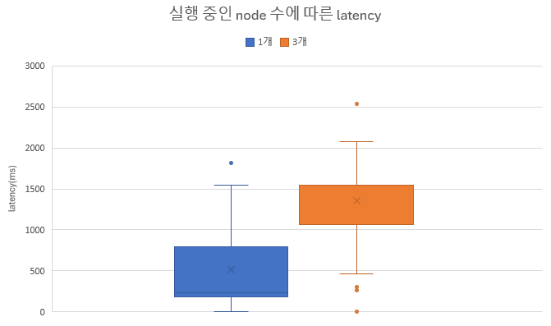
다른 명령 추가
다른 node에서 명령을 추가로 입력하여 queue에 명령이 몰릴 때, latency 확인하기
1/s: 509.6 ms
다른 명령 추가: 1351.1 ms
7

Slide 8
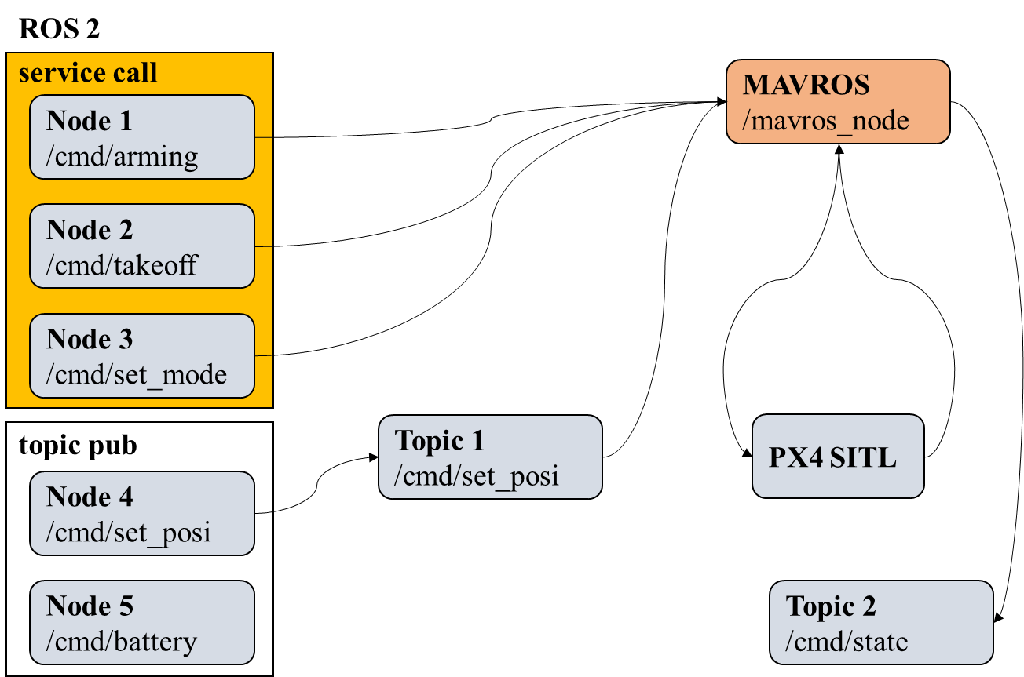
To do 1
각 명령에 따라 priority를 부여하고 latency 측정하기
8

Slide 9
To do 2
만약, priority 반영이 되지 않으면, mavros queue를 priority queue로 변경
KEEEEEEEE KEEPalive message의 priority를 낮추는 방향으로
X: 1.0 Y: 1.0 | X: 1.0 Y: 1.0 | X: 1.0 Y: 1.0 | X: 1.0 Y: 1.0 | X: 1.0 Y: 1.0 | arming | X: 1.0 Y: 1.0 | X: 1.0 Y: 1.0 | X: 1.0 Y: 1.0 | X: 1.0 Y: 1.0
9

Slide 10
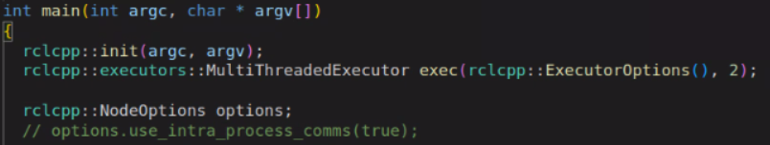
Mavros code
mavros_node.cpp
Queue 수정은 ros2 code(rclcpp) 수정 필요
Mavros code에는 queue나 excutor 관련 코드 X
High/Low callback group으로 나누고, 별도의 static single threaded excutor 사용
10

Slide 11

Advisor : Hoon Sung Chwa
Thank you
Dept of Electronic Engineering & Computer Science, DGIST
Real-Time Computing Lab
Moonyoung Choi (cmy021205@dgist.ac.kr)

